Slide 1


ITEC614 Introduction to Cyber Security
Dr. Farshid Keivanian
Lecturer, Information Technology, PFBS

Slide 2
Access Control
Lecture 7

Slide 3
Previous Lecture…
Have studied…
Hash function
Attacks on hash
Secure Hash Algorithms
Digital signature
ElGamal signature
DSS

Slide 4
Today’s Objectives
To understand the following concepts:
Access control principles
Access control policies
Access control requirements
Access control elements
Discretionary access control Role- based access control: A case study
Access control models

Slide 5
References
Computer Security Principles and Practice (2nd Ed.),
W. Stallings & L. Brown Chapter 4

Slide 6
What is Access Control?
Definition: Access control is the prevention of unauthorized use of resources, including ensuring that resources are used only in authorized manners.

Slide 7
What is Access Control?
Why it matters: Access control is a critical element in computer and network security, safeguarding systems from unauthorized users or malicious activities.

Slide 8
What is Access Control?
Key Concepts:
Authentication: Users and groups authenticate themselves to the system, typically through usernames and passwords, biometrics, or other methods.

Slide 9
What is Access Control?
Authorization: After authentication, users are assigned specific access rights to certain resources, ensuring they can only access what's necessary.

Slide 10
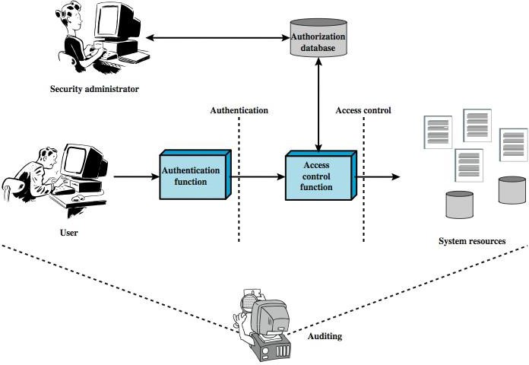
Access Control & AAA Functions
The interaction between a security administrator, user, authentication process, authorization database, and system resources:

Slide 11
Access Control & AAA Functions
Authentication verifies the identity of the user.
Access control determines what resources the authenticated user can access.
Auditing tracks the actions performed by the user on the system.

Slide 12
Access Control & AAA Functions
This process ensures secure and controlled access to sensitive system resources.

Slide 13
Types of Access Control
Discretionary Access Control (DAC): The owner of the resource decides who gets access. Example: A file owner determines who can read or modify the file.

Slide 14
Types of Access Control
Mandatory Access Control (MAC): Access rights are regulated by a central authority. Example: Military systems where clearance levels determine access to information.

Slide 15
Types of Access Control
Role-Based Access Control (RBAC): Users are assigned roles, and roles are given permissions. Example: A manager has access to employee records, while a general staff member does not.

Slide 16
Types of Access Control
Attribute-Based Access Control (ABAC): Access is determined by attributes like location, time, or device used. Example: A user can access sensitive data only during office hours.

Slide 17
Types of Access Control
Attribute-Based Access Control (ABAC): Access is determined by attributes like location, time, or device used. Example: A user can access sensitive data only during office hours.

Slide 18
Example
Australian Government Network Security: In the Australian Government's IT systems, Role-Based Access Control (RBAC) is widely used. For example, public servants working in different departments, such as the Department of Health, will have access only to health-related information, and not to data from other departments.

Slide 19
Research Discussion Question
How does access control impact cybersecurity in organizations, and what would be the consequences of weak access control measures in the context of Australian government data systems?

Slide 20
Access Control Requirements
Reliable Input
Explanation: For a system to ensure security, it must rely on reliable input from sources such as IP addresses. The system must have mechanisms to validate the authenticity of the source.
Example: An organization in Australia validates the source IP address to ensure employees accessing company data are within the authorized network.

Slide 21
Access Control Requirements
Least Privilege
Explanation: Each user or entity should only be granted the minimum resources and permissions necessary to perform their task.
Example: A marketing employee in an Australian company should not have access to financial data or HR records unless it is necessary for their role.

Slide 22
Access Control Requirements
Open and Closed Policies
Explanation:
Closed Policy: Only explicitly authorized accesses are allowed.
Open Policy: Everything is allowed except explicitly prohibited accesses.
Example: An Australian government department might apply a Closed Policy to sensitive documents, ensuring only authorized users can access them.

Slide 23
Access Control Requirements
Policy Combinations and Conflict Resolution
Explanation: Multiple access control policies may need to be applied, requiring mechanisms to handle any potential conflicts.
Example: In an Australian university, a student may be allowed access to general resources but restricted from access to exam results based on their enrolment status.

Slide 24
Access Control Requirements
Administrative Policies
Explanation: Administrative policies specify who can add, delete, or modify access rules, ensuring that access control rules remain effective.
Example: In a university, only the IT security admin has the authority to change user permissions for the course management system.

Slide 25
Access Control Elements
Subject
Explanation: A subject is an entity that requests access to an object (e.g., user or application).
Example: A user logging into a computer system in an Australian office is considered a subject.

Slide 26
Access Control Elements
Object
Explanation: An object is the resource to which access is controlled (e.g., files, databases, records).
Example: A file storing employee details is an object in the Australian government’s records system

Slide 27
Access Control Elements
Access Right
Explanation: Access rights define how a subject interacts with an object (e.g., read, write, delete).
Example: An Australian bank employee might have read access to customer account details but not the right to delete data.

Slide 28
Research Discussion Question
In the context of Australian government organizations, how does the Least Privilege principle help mitigate security risks, and what challenges might arise when applying it in a large-scale system with many users?

Slide 29
Discretionary Access Control (DAC)
Definition: DAC is a general approach to access control where the owner of a resource determines who has access to it. In DAC systems, the access rights are specified for each subject (e.g., user) to each object (e.g., file).
Key Features:
Uses an access matrix to manage permissions.
Users (subjects) have specified access rights to resources (objects).

Slide 30
Access Matrix
What is an Access Matrix?
It is a matrix where:
Rows represent subjects (e.g., users).
Columns represent objects (e.g., files).
Each cell in the matrix indicates the access rights a subject has to an object.

Slide 31
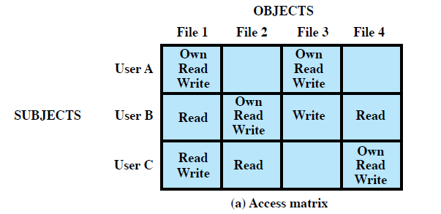
Access Matrix Example
Subjects: User A, User B, User C
Objects: File 1, File 2, File 3, File 4
Access Rights: Define what each subject can do (e.g., Read, Write, Own).
Example:
User A can own, read, write File 1, while User C can only read File 1.

Slide 32
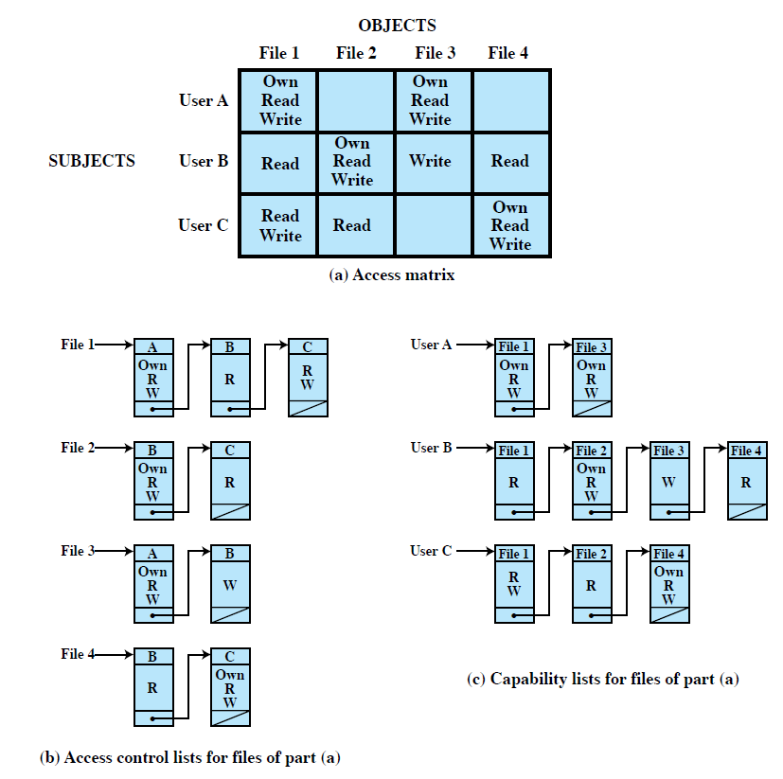
Access Control Lists (ACLs) & Capability Tickets
Access Control Lists (ACLs)
Decomposition by Columns: The matrix can be decomposed by columns into Access Control Lists (ACLs).
Each ACL lists subjects with their access rights for a particular resource.
Example: ACL for File 1 might include:
User A: Own, Read, Write
User B: Read

Slide 33
Access Control Lists (ACLs) & Capability Tickets
Advantages:
Easy to check access rights for a specific resource.
Not efficient for finding what rights a specific user has across all objects.

Slide 34
Access Control Lists (ACLs) & Capability Tickets
Capability Tickets
Decomposition by Rows: Decomposing the matrix by rows creates capability tickets, specifying a user's authorized objects and operations.
Example: User A might have a ticket stating they have Own, Read, Write access to File 1 and File 3.

Slide 35
Access Control Lists (ACLs) & Capability Tickets
Advantages:
Easier to check what a specific user can access.

Slide 36
LGD Scheme for DAC (Lampson, Graham, Denning)
Background: The LGD scheme, developed in 1971, extends the basic DAC concept. It uses an extended access control matrix that includes not only access to files but also to processes and devices.

Slide 37
LGD Scheme for DAC (Lampson, Graham, Denning)
 | Files (F1, F2) | Processes (P1, P2) | Disk Drives (D1, D2)
S1 | Control, Owner | Read, Write | Seek
S2 | Write | Execute | Owner
The LGD scheme is used in complex systems where objects are not just files but include processes and devices, giving more control over system security.

Slide 38
Research Discussion Question
How can the Access Matrix and Access Control Lists (ACLs) be used to enhance the security of cloud-based applications in Australian organizations?
Discuss the challenges in scaling access control in large systems with multiple users and resources. How would the Least Privilege principle play a role in mitigating security risks?

Slide 39
Understanding DAC, LGD Scheme, and RBAC
How DAC Works:
The access matrix lists subjects (users) in one dimension and objects (resources) in the other. Each entry specifies the access rights (e.g., read, write) that a subject has for a specific object.

Slide 40
Understanding DAC, LGD Scheme, and RBAC
Example:
In an Australian university system, Professors might have the ability to write to a student record file, while students may only have read access.

Slide 41
Understanding DAC, LGD Scheme, and RBAC
LGD Scheme for DAC
Overview: The LGD scheme (Lampson, Graham, and Denning, 1971) extends DAC by incorporating more complex control over objects like files, processes, and disk drives.

Slide 42
Understanding DAC, LGD Scheme, and RBAC
How it Works:
Subjects (users) issue requests for operations on objects (resources). Each access attempt triggers a series of steps where the system checks the access matrix to determine if the operation is allowed.

Slide 43
Understanding DAC, LGD Scheme, and RBAC
Example:
File system access in an Australian company could involve the LGD system checking if a user has read rights before granting access to a confidential file.

Slide 44
Understanding DAC, LGD Scheme, and RBAC
Role-Based Access Control (RBAC)
Definition: RBAC assigns access rights based on roles rather than individual users. Each user is assigned to a role, and each role is given specific access rights to resources.

Slide 45
Understanding DAC, LGD Scheme, and RBAC
Key Features:
Users can have dynamic roles assigned to them.
Access control decisions are made based on the user’s role.
Example:
In an Australian hospital, the doctor role might have access to patient health records, while the nurse role can access medication schedules but not health history.

Slide 46
Understanding DAC, LGD Scheme, and RBAC
Example:
Australian University System:
Role 1 (Lecturer): Access to course materials, student grades, and exams.
Role 2 (Student): Access to course materials and personal grades.
Role 3 (Administrator): Full access to all system resources including user management, grades, and course configuration.

Slide 47
Understanding DAC, LGD Scheme, and RBAC
Comparison Table: DAC vs LGD vs RBAC
Feature | DAC | LGD Scheme | RBAC
Control Authority | Resource owner | Extended access control matrix | Roles assigned by the system or admin
Access Type | Directly managed by the owner | Complex control over files, processes | Roles with pre-defined permissions
Implementation | Access matrix | Advanced object management with steps | Role assignments and resource links
Example | File access by user A | Access control across files, processes | Hospital staff roles (Doctor, Nurse)

Slide 48
Research Discussion Question
How do the LGD Scheme and RBAC methods of access control compare in terms of scalability in large organizations, like Australian government departments or hospitals, where access needs to be both secure and flexible? Discuss potential challenges of each system in such environments.

Slide 49
Role Hierarchies in RBAC
What is Role Hierarchy?
Role hierarchies reflect the hierarchical structure of roles within an organization, where roles with greater responsibility have more access rights.

Slide 50
Role Hierarchies in RBAC
Key Points:
Higher-level roles inherit the permissions of lower-level roles.
Subordinate roles can have a subset of the permissions of superior roles.
Example:
In an Australian government agency, a Director might have full access to all resources, whereas a Project Manager only has access to specific project-related documents.

Slide 51
Constraints in RBAC
Definition: Constraints are rules that define relationships between roles or set conditions related to roles in an RBAC system.

Slide 52
Constraints in RBAC
Types of Constraints:
Mutually Exclusive Roles:
Users can be assigned only one role within a mutually exclusive set.
Example: A user cannot have both HR and Finance roles at the same time to avoid conflicts of interest.

Slide 53
Constraints in RBAC
Cardinality:
Limits the number of users that can be assigned to a role.
Example: There can only be a maximum of 5 Admin roles in an organization.

Slide 54
Constraints in RBAC
Prerequisite:
A user can only be assigned a role if they are already assigned to another specific role.
Example: To be promoted to a Manager role, a user must first hold a Team Lead role.

Slide 55
Comparison Table: RBAC Concepts
Feature | RBAC | Mutually Exclusive Roles | Cardinality | Prerequisite
Key Concept | Assigning roles to users | Users can only hold one role | Setting a limit on number of roles | Conditional role assignment

Slide 56
Comparison Table: RBAC Concepts
Feature | RBAC | Mutually Exclusive Roles | Cardinality | Prerequisite
Examples | Roles assigned to users in a company | HR vs Finance roles | Max of 5 admins per system | Role promotion requires prior role

Slide 57
Comparison Table: RBAC Concepts
Feature | RBAC | Mutually Exclusive Roles | Cardinality | Prerequisite
Purpose | Control access based on roles | Prevent conflicts of interest | Prevent role overload | Implement least privilege

Slide 58
Research Discussion Question
How does the concept of role hierarchies in RBAC improve security and efficiency in large organizations, such as Australian government departments or healthcare systems? Discuss the challenges and benefits of implementing these hierarchies in dynamic environments where user roles might frequently change.

Slide 59
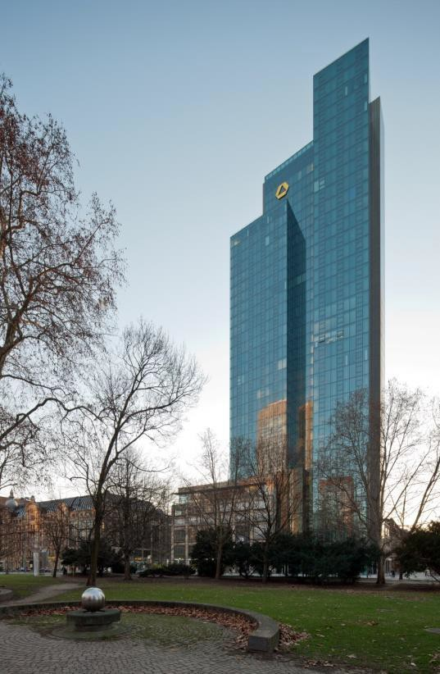
A Case Study: RBAC For a Bank
Dresdner Bank (one of Germany’s largest banking corporations, based in Frankfurt) used a simple DAC system prior 1990s – They later introduced an RBAC scheme
Roles are defined by a combination of official
position and job function
A role hierarchy is defined in such a way that one role is superior to another if its position is superior and their functions are identical
E.g., Role B (in the table on next slide) may have as many or more access rights than Role A

Slide 60
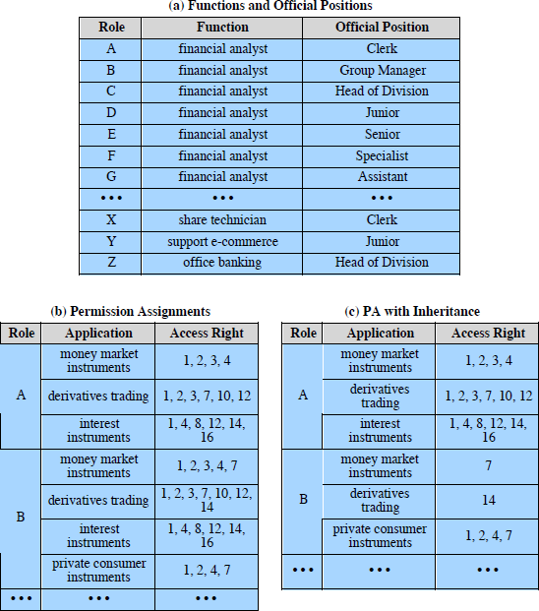
Roles and Their Access Rights

Slide 61
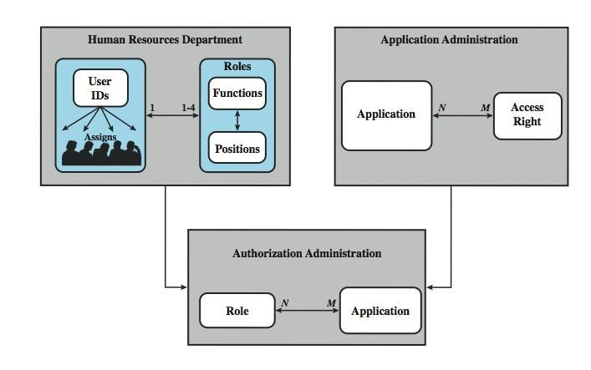
RBAC For a Bank

Slide 62
Some Interesting Figures
Within the bank, there are 65 official positions (ranging from
a Clerk, through Branch Manager, to a Member of the Board)
These positions are combined with 368 job functions
Potentially, there are 23,920 different roles
The number of roles in current use is about 1,300
On average, 42,000 accesses are processed for different applications each day, by the Authorization Administration module

Slide 63
Bell-LaPadula (BLP) Model
Overview: This security model, developed in the 1970s, is focused on confidentiality. It applies security classifications and clearance levels to control access to objects.

Slide 64
Bell-LaPadula (BLP) Model
Key Points:
Objects are assigned security classifications: top secret, secret, confidential, restricted, and unclassified.
Subjects are assigned security clearances.
Security classes control access between subjects and objects, ensuring that only those with appropriate clearance can access classified information.

Slide 65
Bell-LaPadula (BLP) Model
Example:
In an Australian government system, highly classified files may be restricted to only those with 'top secret' clearance, while 'secret' files can be accessed by a broader group.

Slide 66
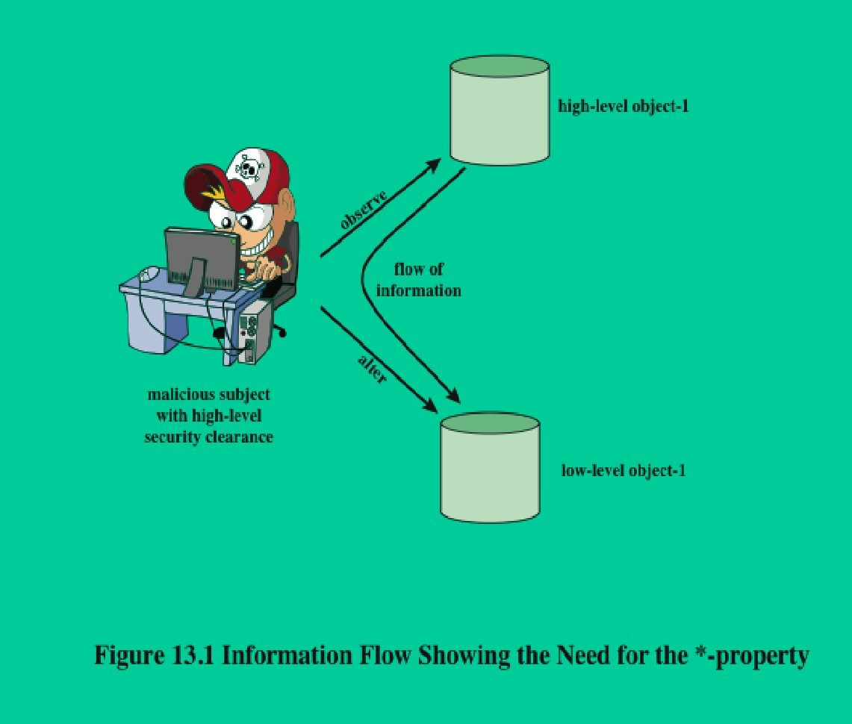
Two Properties
No Read Up (ss-property): A subject can only read an object if the object’s security level is less than or equal to the subject’s clearance level.
No Write Down (*-property): A subject can only write to an object if the object’s security level is greater than or equal to the subject’s clearance level.
Read Down, Write Up

Slide 67
Two Properties
Example:
In a bank’s document system, an employee with 'confidential' clearance cannot access 'top secret' information but may read 'confidential' or 'restricted' documents.
Read Down, Write Up

Slide 68
BLP Formal Description
SS-property: A subject can read an object only if the subject’s level is greater than or equal to the object’s level.
Based on current state of system (b, M, f, H):
(current access set b, access matrix M, level function f, hierarchy H)
Three BLP properties:
ss-property: (S_{i}, O_{j}, read) has f_{c}(S_{i}) ≥ f_{o}(O_{j})
*-property: (S_{i}, O_{j}, append) has f_{c}(S_{i}) ≤ f_{o}(O_{j}) and
(S_{i}, O_{j}, write) has f_{c}(S_{i}) = f_{o}(O_{j}) ds-property: (S_{i}, O_{j}, A_{x}) implies A_{x}  M[S_{i},O_{j}]

Slide 69
BLP Formal Description
Write-Down Property: A subject can write an object only if the subject’s level is greater than or equal to the object’s level.
Based on current state of system (b, M, f, H):
(current access set b, access matrix M, level function f, hierarchy H)
Three BLP properties:
ss-property: (S_{i}, O_{j}, read) has f_{c}(S_{i}) ≥ f_{o}(O_{j})
*-property: (S_{i}, O_{j}, append) has f_{c}(S_{i}) ≤ f_{o}(O_{j}) and
(S_{i}, O_{j}, write) has f_{c}(S_{i}) = f_{o}(O_{j}) ds-property: (S_{i}, O_{j}, A_{x}) implies A_{x}  M[S_{i},O_{j}]

Slide 70
BLP Formal Description
Example:
A clerk at a bank can access less-sensitive data (like public financial reports), while executives with 'top secret' clearance can access highly sensitive customer information.

Slide 71
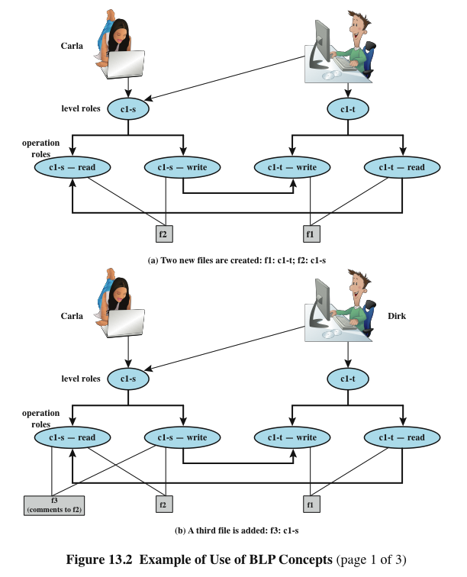
BLP Example
Example:
In an Australian healthcare system, a doctor (higher integrity level) can modify medical records but cannot lower the quality or integrity of those records.

Slide 72
Chinese Wall Model
Purpose: Prevents conflicts of interest by controlling information flow based on the history of access.
Key Points:
Once a subject accesses information from one dataset (like company data), they are restricted from accessing any conflicting datasets (such as competitor data).

Slide 73
Chinese Wall Model
Access Rules:
Simple Security: A subject can only read data from a company they’ve already accessed, or from a different company they have not yet interacted with.
Example:
A financial analyst in an Australian firm with access to data from Company A cannot access sensitive data from Company B (a direct competitor) without conflict of interest.

Slide 74
Chinese Wall Model
Research Discussion Question:
Question: How do the Bell-LaPadula and Biba models differ in terms of data security, and how would you apply these models in a real-world business scenario like a bank or hospital?

Slide 75
Summary
We have studied:
Access control principles
Subjects, objects, access rights
Discretionary access control
Role-based access control
A case study
Three access control models

Slide 76
Next Week
We will study
Protecting a CS Domain

Slide 77

Questions?

